Slide 1
Tree in C
1. What are Trees in C?
In mathematical terminology, a tree is referred to as a finite and non-empty set of elements. It can also be regarded as an abstract model of a hierarchical structure that follows a parent-child relationship.
In programming terminology, a tree is nothing but a non-linear data structure that has multiple nodes, rather than just one like we saw in a linked list, stack, and queue.

Slide 2
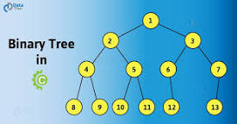

Slide 3
Binary tree
Binary Tree
In this tutorial, you will learn about binary tree and its different types. Also, you will find working examples of binary tree in C, C++, Java and Python.
A binary tree is a tree data structure in which each parent node can have at most two children. Each node of a binary tree consists of three items:
data item
address of left child
address of right child

Slide 4
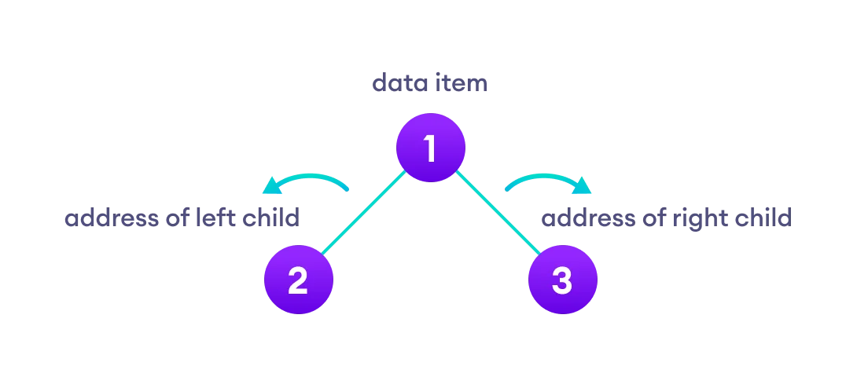

Slide 5
Binary Tree Representation A node of a binary tree is represented by a structure containing a data part and two pointers to other structures of the same type. struct node { int data; struct node *left; struct node *right; };

Slide 6
Binary Tree ADT A binary tree is a tree in which no node can have more than two children. The maximum degree of any node is two. This means the degree of a binary tree is either zero or one or two.

Slide 7
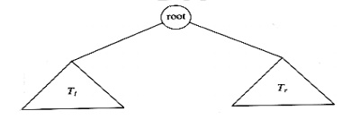
In the above fig., the binary tree consists of a root and two sub trees Tl & Tr. All nodes to the left of the binary tree are referred as left subtrees and all nodes to the right of a binary tree are referred to as right subtrees.

Slide 8
Implementation A binary tree has at most two children; we can keep direct pointers to them. The declaration of tree nodes is similar in structure to that for doubly linked lists, in that a node is a structure consisting of the key information plus two pointers (left and right) to other nodes.

Slide 9
Binary Tree node declaration typedef struct tree_node *tree_ptr; struct tree_node { element_type element; tree_ptr left; tree_ptr right; }; typedef tree_ptr TREE;

Slide 11
declaration
struct BinNode{
int info;
struct BinNode *left;
struct BinNode *right
};
typedef struct BinNode BinNodeType;
BinNodetype *Root;
/*Data field:the data to be stored*/
/*pointer to the root of the left subtree*/
/*pointer to the root of right subtree*/

Slide 12
Search Operation
Whenever an element is to be searched, start searching from the root node. Then if the data is less than the key value, search for the element in the left subtree. Otherwise, search for the element in the right subtree. Follow the same algorithm for each node.

Slide 13
Algorithm
struct node* search(int data){
struct node *current = root;
printf("Visiting elements: ");
while(current->data != data){
if(current != NULL) {
printf("%d ",current->data);
//go to left tree
if(current->data > data){
current = current->leftChild;
} //else go to right tree
else {
current = current->rightChild;
}
//not found
if(current == NULL){
return NULL;
}
}
}
return current;
}

Slide 14
Insert Operation
Whenever an element is to be inserted, first locate its proper location. Start searching from the root node, then if the data is less than the key value, search for the empty location in the left subtree and insert the data. Otherwise, search for the empty location in the right subtree and insert the data.

Slide 15
Algorithm
void insert(int data) {
struct node *tempNode = (struct node*) malloc(sizeof(struct node));
struct node *current;
struct node *parent;
tempNode->data = data;
tempNode->leftChild = NULL;
tempNode->rightChild = NULL;
//if tree is empty
if(root == NULL) {
root = tempNode;
} else {
current = root;
parent = NULL;
while(1) {
parent = current;
//go to left of the tree
if(data < parent->data) {
current = current->leftChild;
//insert to the left
if(current == NULL) {
parent->leftChild = tempNode;
return;
}
} //go to right of the tree
else {
current = current->rightChild;
//insert to the right
if(current == NULL) {
parent->rightChild = tempNode;
return;
}
}
}
}
}

